Slide 1

LAST TIME
ADVENTURE
Last Time Group Presentation

Slide 2
MEMBER LIST
Vu Thanh An
ITITIU21148
Nguyen Hoang Minh Nghia
ITITIU21255
Nguyen Ha Thanh
ITITIU21144
Phan Nguyen Khanh Nguyen
ITCSIU21209

Slide 3
TABLE OF CONTENTS
01
02
03
INTRODUCTION
OVERVIEW & FEATURE
GAME DEVELOPMENT
Introduction to
the game
Game Genre & Graphics Style
Development Tools & Process
04
05
CHALLENGES & SOLUTION
FUTURE PLAN
Development difficulties
Planned Upcoming Features

Slide 4
01
INTRODUCTION

Slide 5
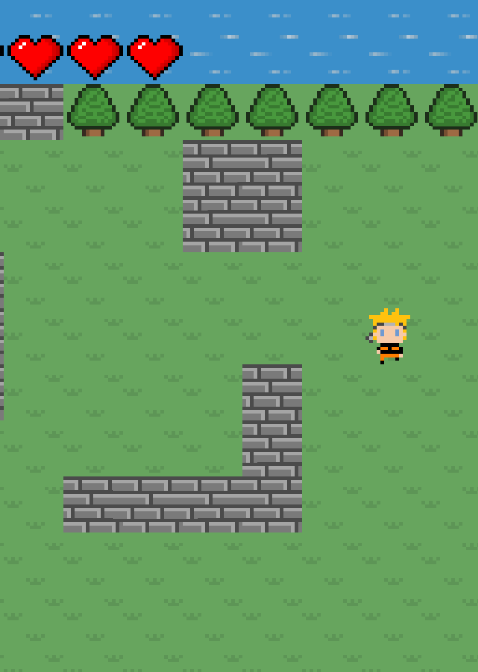
LAST TIME ADVENTURE
"Last Time Adventure" is an immersive 2D top-down wave-based survival game designed to challenge players' strategic thinking and reflexes.
Set in a vibrant 8-bit graphical world, the game combines nostalgic elements with modern gameplay mechanics, offering a unique and engaging experience.
The objective is to survive as long as possible against increasingly difficult waves of enemies, then finally to defeat a boss.

Slide 6
02
OVERVIEW & FEATURE

Slide 7


GAME GENRE & GRAPHIC STYLE
2D Top-Down Wave-Based Survival
Players view the game from a top-down perspective
Defeat successive waves of enemies, each more challenging than the last.
8-bit, Pixel Art Style
Reminiscent of classic games from the 80s and 90s.
Detailed pixel art adds charm and character to the game

Slide 8



CORE MECHANICS
SURVIVAL & STRATEGY
Players must strategize to manage resources and navigate through obstacles
TERRAIN NAVIGATION
Includes various terrains, such as forests, rivers, and stone paths
Wave-Based Combat
Each wave presents a new challenge, with different types and numbers of enemies

Slide 9
03
GAME DEVELOPMENT

Slide 10



DEVELOPMENT TOOLS
ENVIRONMENT | LIBRARIES - FRAMEWORK
Visual Studio Code IntelliJ IDEA GitHub | Java Oracle

Slide 11
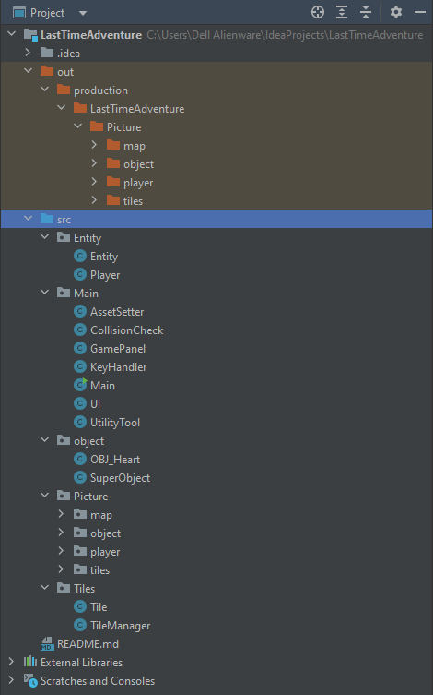
PROJECT STRUCTURE
Entity: Handles the player and enemy characters, defining their behaviors and interactions.
Main: Loads assets, checks collisions, runs the UI, handles keyboard input, and manages game sounds.
Object: Manages game objects such as health items and other interactive objects.
Picture: Stores image assets for maps, objects, player characters, and tiles.
Tiles: Loads and manages the game map, defining the properties and rendering of tiles.

Slide 12
04
CHALLENGES & SOLUTION

Slide 13

THE CHALLENGE #1
Designing Intuitive Yet Challenging Enemy AI
Ensuring enemies are challenging but fair, with varied behaviors to keep gameplay interesting.

Slide 14

THE SOLUTION #1
Iterative Testing and Feedback Loops
Regular playtesting sessions to gather feedback and make necessary adjustments.

Slide 15
THE CHALLENGE #2
Balancing Game Difficulty:
Adjusting game mechanics to provide a smooth difficulty curve that keeps players engaged.

Slide 16
THE SOLUTION #2
AI Optimization and Balancing Techniques
Implementing algorithms to create balanced and engaging enemy behaviors

Slide 17
THE CHALLENGE #3
Creating Seamless and Responsive Controls
Ensuring that controls are intuitive and responsive to player inputs.

Slide 18
THE SOLUTION #3
User Experience Enhancements
Fine-tuning controls and UI elements to ensure a smooth and enjoyable gameplay experience

Slide 19
05
FUTURE PLAN

Slide 20
FUTURE PLAN
We are highly recommend to develop the following features if there is an opportunity to continue developing the project:
Additional Levels and Environments
More Enemy Types and Boss Fights
Adding collectable Power-Ups and Abilities
Multiplayer Mode

Slide 21
THANK YOU FOR LISTENING
Please raise your question if needed

